Slide 1


Azərbaycan Dövlət Neft və Sənaye Universiteti
Calculus
Single Variable

Slide 2
Preparation for Calculus:
Linear Models
and
Rates of Change

Slide 3
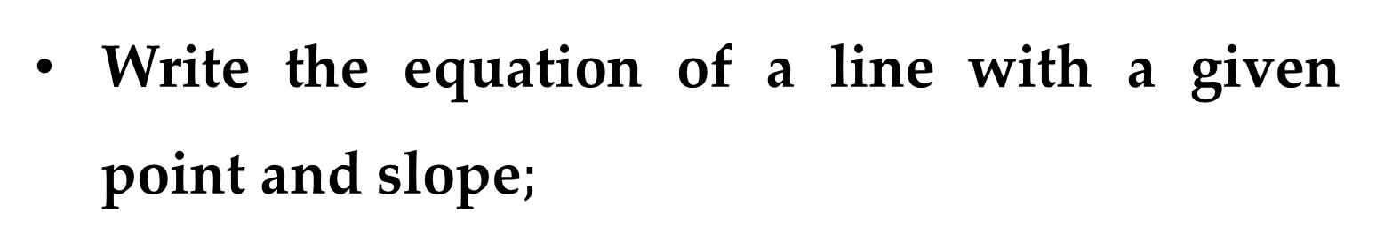
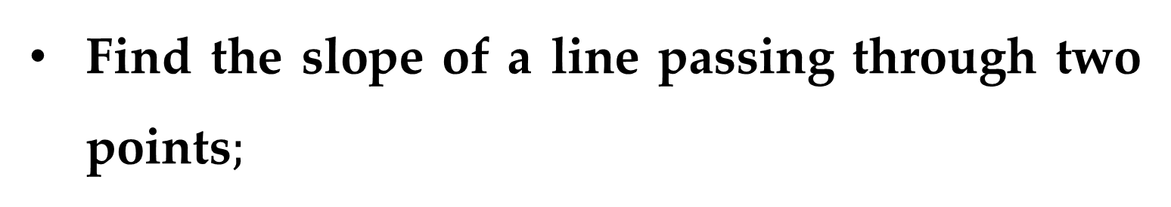
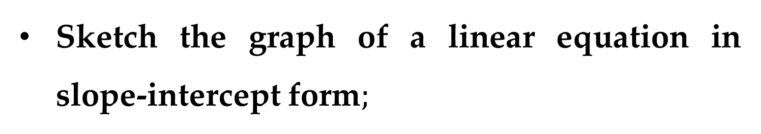
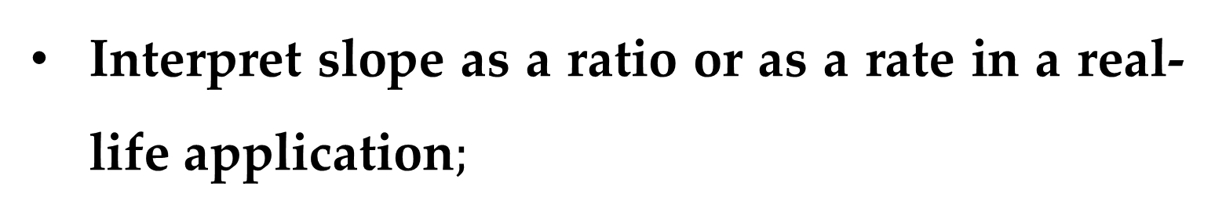
$$Outline$$
Find the slope of a line passing through two points$;$
Write the equation of a line with a given point and slope$;$
Interpret slope as a ratio or as a rate in a real-life application$;$
Sketch the graph of a linear equation in slope-intercept form$;$

Slide 4
$$Outline$$
Write equations of lines that are parallel or perpendicular to a given line.

Slide 5
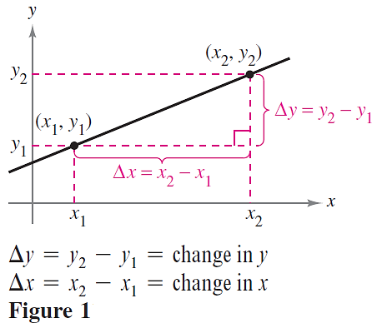
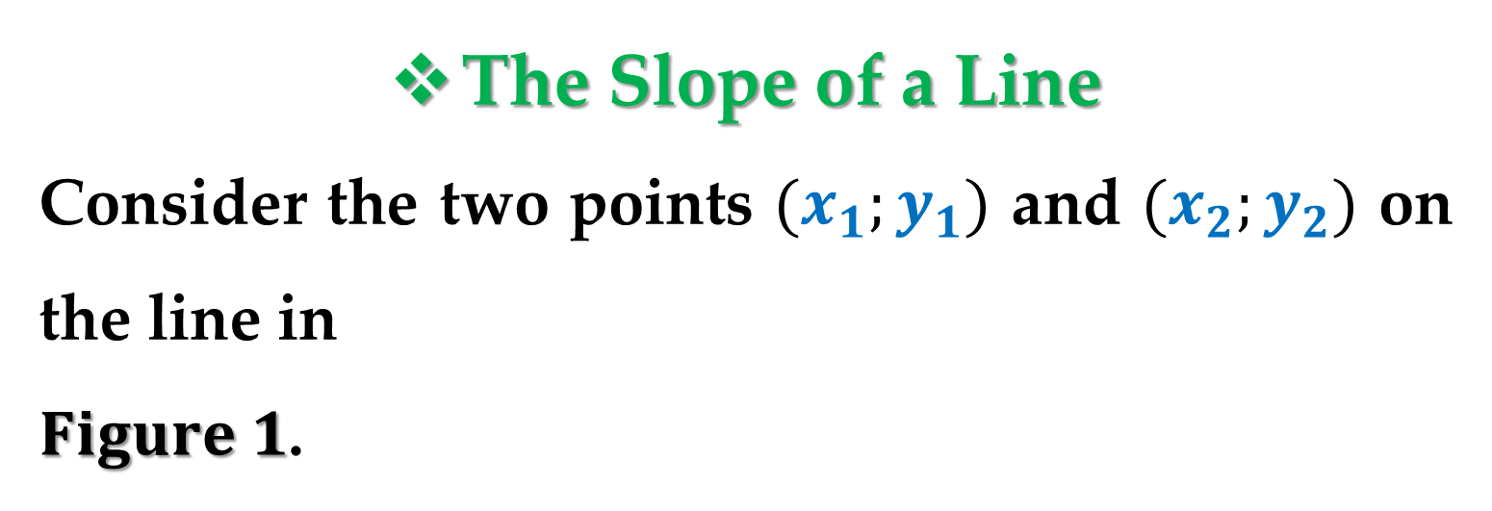
The Slope of a Line
Consider the two points $(x_{1};y_{1})$ and $(x_{2};y_{2})$ on the line in
$Figure 1$.

Slide 6
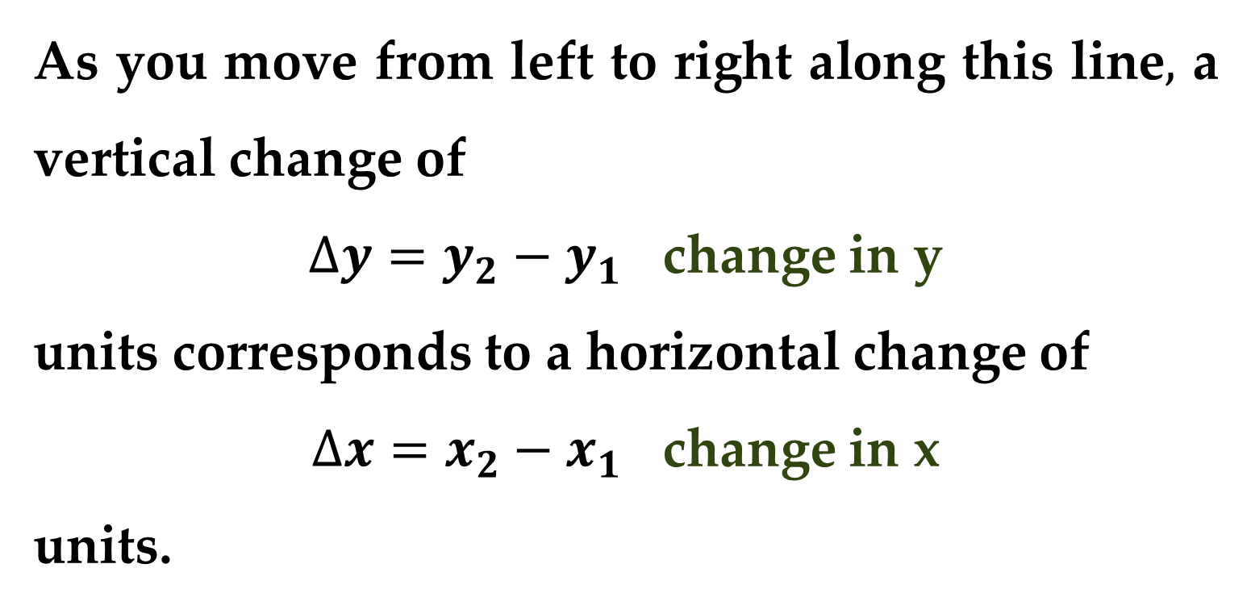
As you move from left to right along this line$,$ a vertical change of
$∆y=y_{2}−y_{1}$ change in y
units corresponds to a horizontal change of
$∆x=x_{2}−x_{1}$ change in x
units.

Slide 7
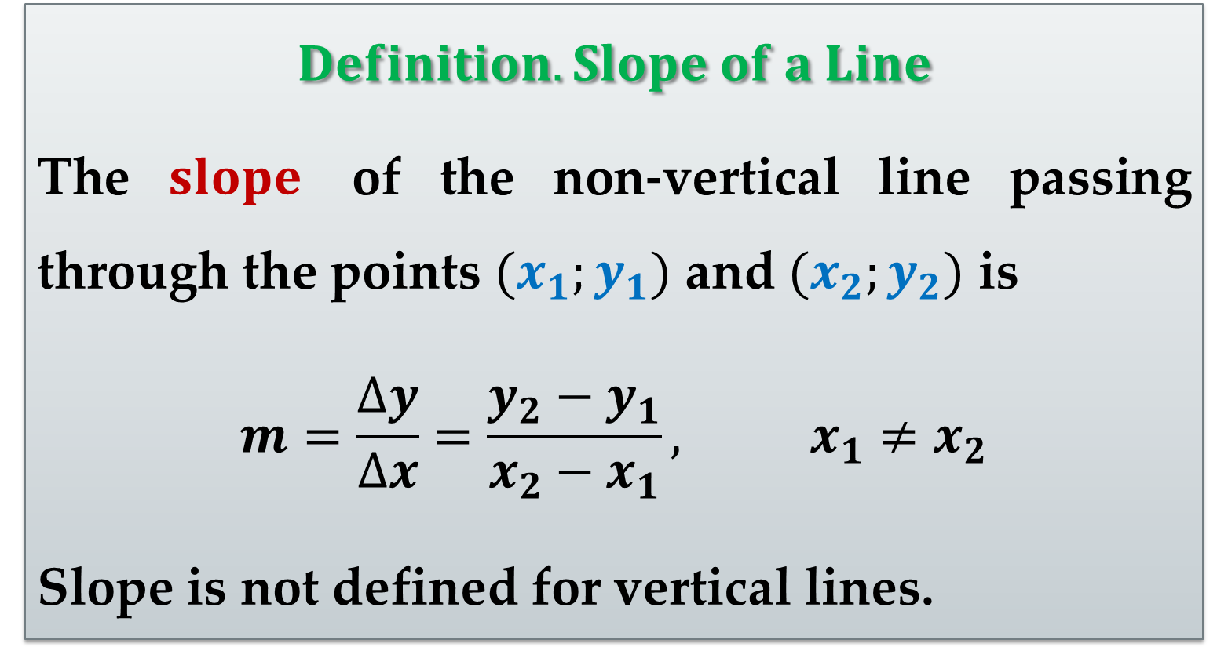
$$Definition. Slope of a Line$$
The $slope$ of the non-vertical line passing through the points $(x_{1};y_{1})$ and $(x_{2};y_{2})$ is
$$m=\frac{∆y}{∆x}=\frac{y_{2}−y_{1}}{x_{2}−x_{1}}, x_{1}≠x_{2}$$
Slope is not defined for vertical lines.

Slide 8
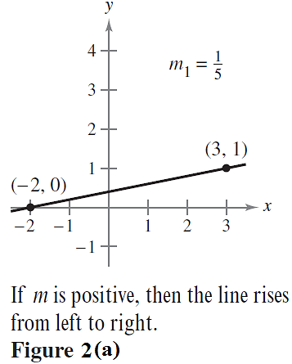
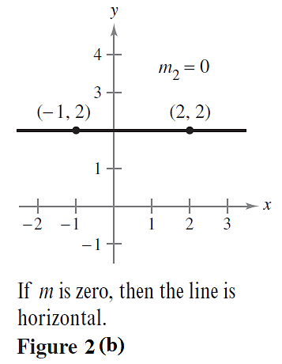
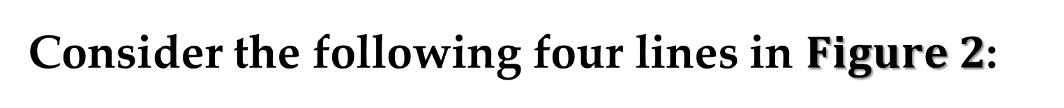
Consider the following four lines in $Figure 2$:

Slide 9
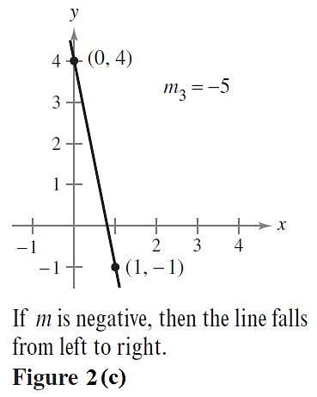
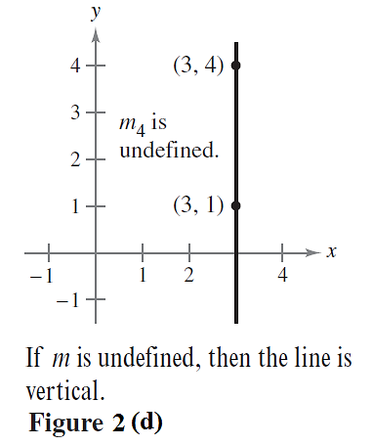
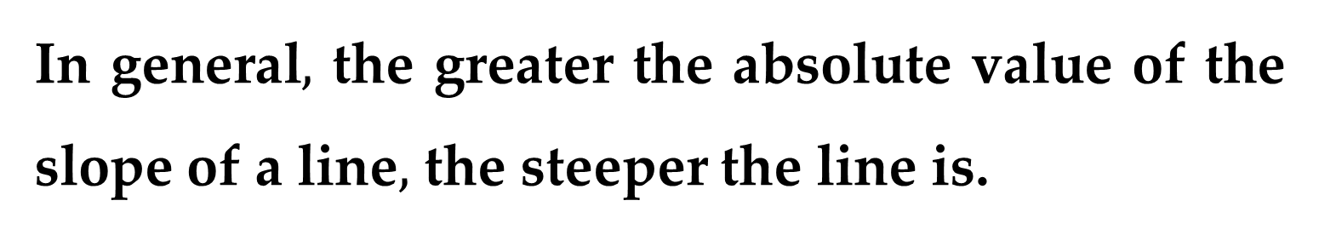
In general$,$ the greater the absolute value of the slope of a line$,$ the steeper the line is.

Slide 10
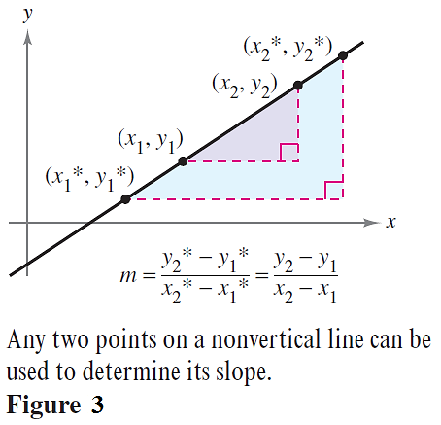
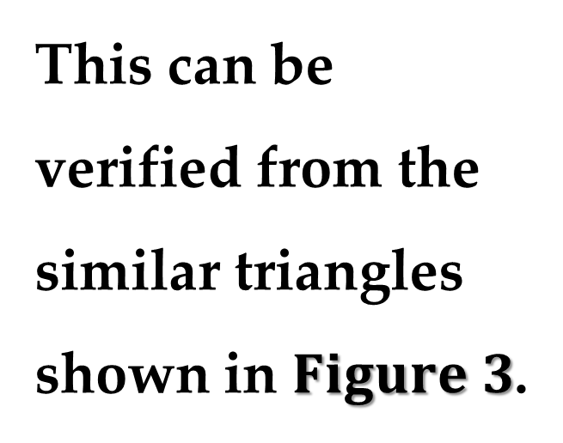
Equations of Lines
Any two points on a non-vertical line can be used to calculate its slope.
This can be verified from the similar triangles shown in $Figure 3$.

Slide 11
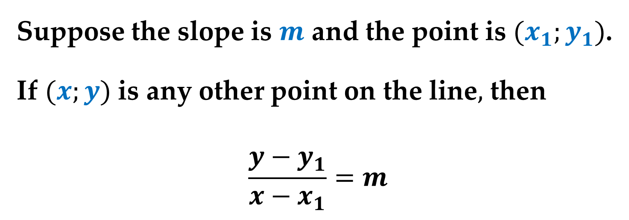
You can write an equation of a non-vertical line if you know the slope of the line and the coordinates of one point on the line.
Suppose the slope is $m$ and the point is $(x_{1};y_{1})$.
If $(x;y)$ is any other point on the line$,$ then
$$\frac{y−y_{1}}{x−x_{1}}=m$$

Slide 12
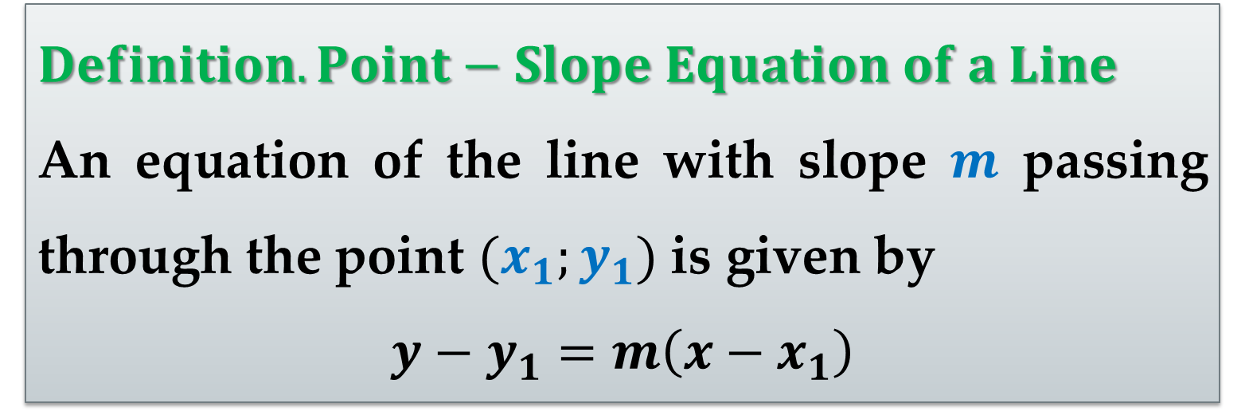
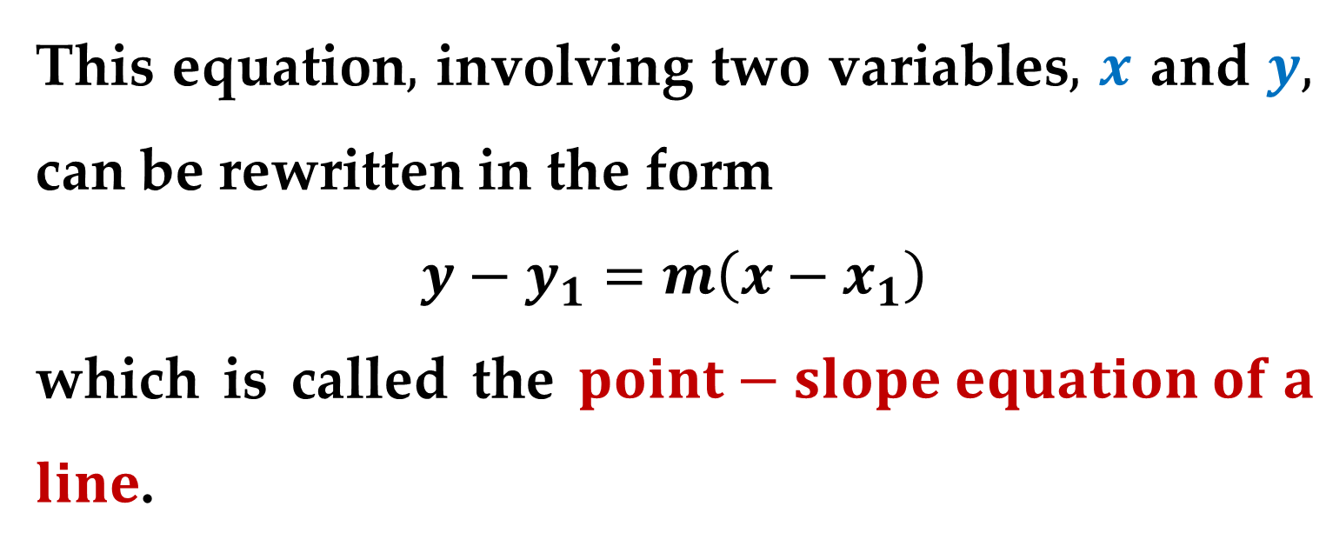
This equation$,$ involving two variables$,$ $x$ and $y,$ can be rewritten in the form
$$y−y_{1}=m\left(x−x_{1}\right)$$
which is called the $point−slope equation of a$ $line$.
$Definition. Point−Slope Equation of a Line$
An equation of the line with slope $m$ passing through the point $(x_{1};y_{1})$ is given by
$$y−y_{1}=m\left(x−x_{1}\right)$$

Slide 13
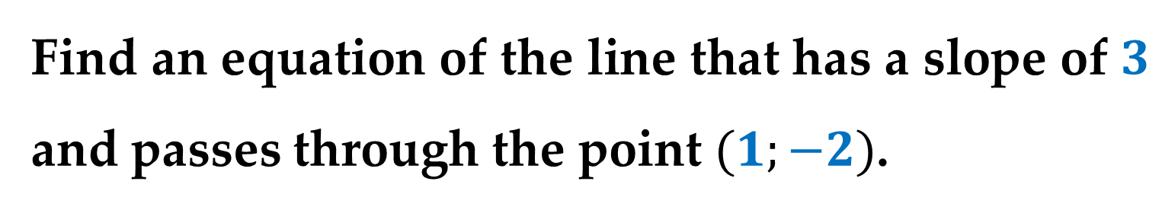

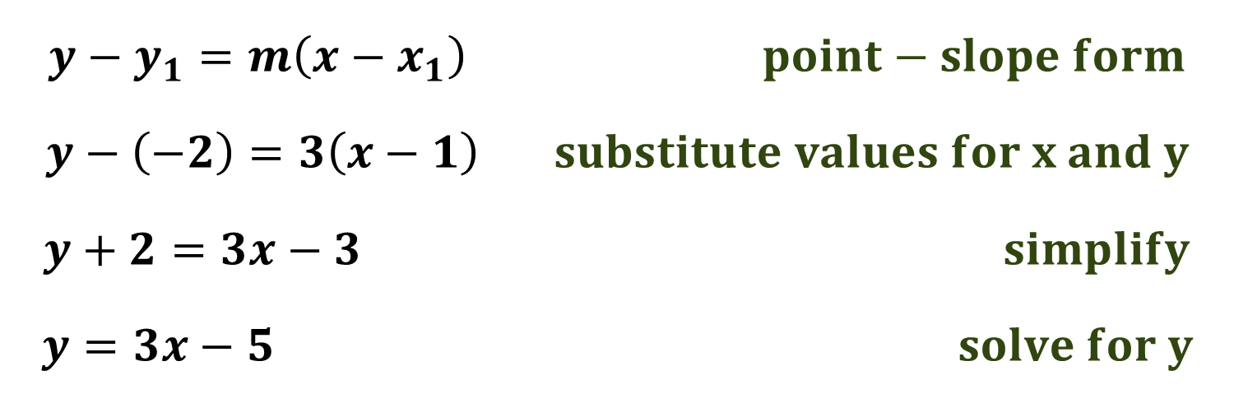
$Example 1$. Finding an Equation of a Line
Find an equation of the line that has a slope of $3$ and passes through the point $(1;−2)$.
Solution
$$y−y_{1}=m\left(x−x_{1}\right) point−slope form$$
$$y−\left(−2\right)=3\left(x−1\right) substitute values for x and y$$
$$y+2=3x−3 simplify$$
$$y=3x−5 solve for y$$

Slide 14
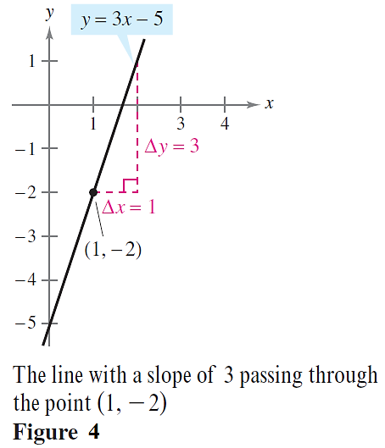
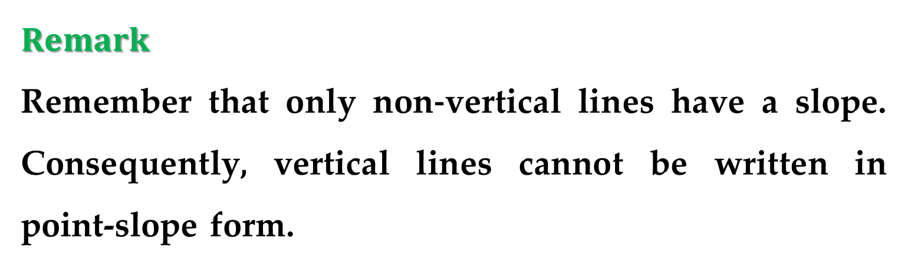
Solution (continued)
$Remark$
Remember that only non-vertical lines have a slope. Consequently, vertical lines cannot be written in point-slope form.

Slide 15
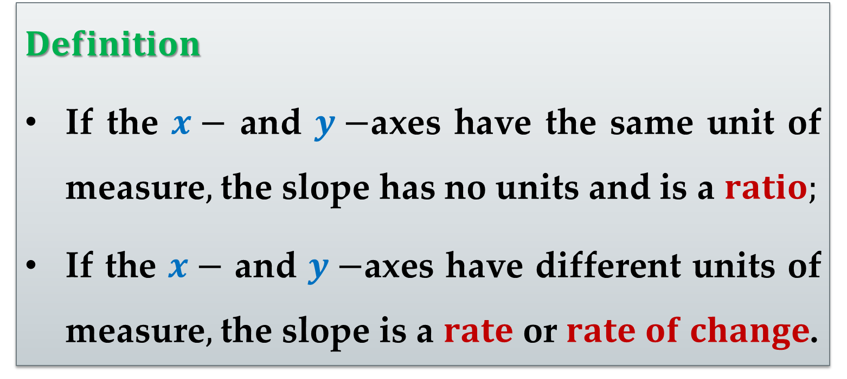
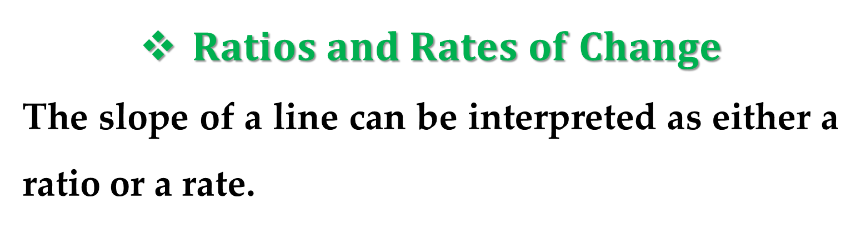
$Ratios and Rates of Change$
The slope of a line can be interpreted as either a ratio or a rate.
$Definition$
If the $x−$ and $y−$axes have the same unit of measure$,$ the slope has no units and is a $ratio;$
If the $x−$ and $y−$axes have different units of measure$,$ the slope is a $rate$ or $rate of change$.

Slide 16

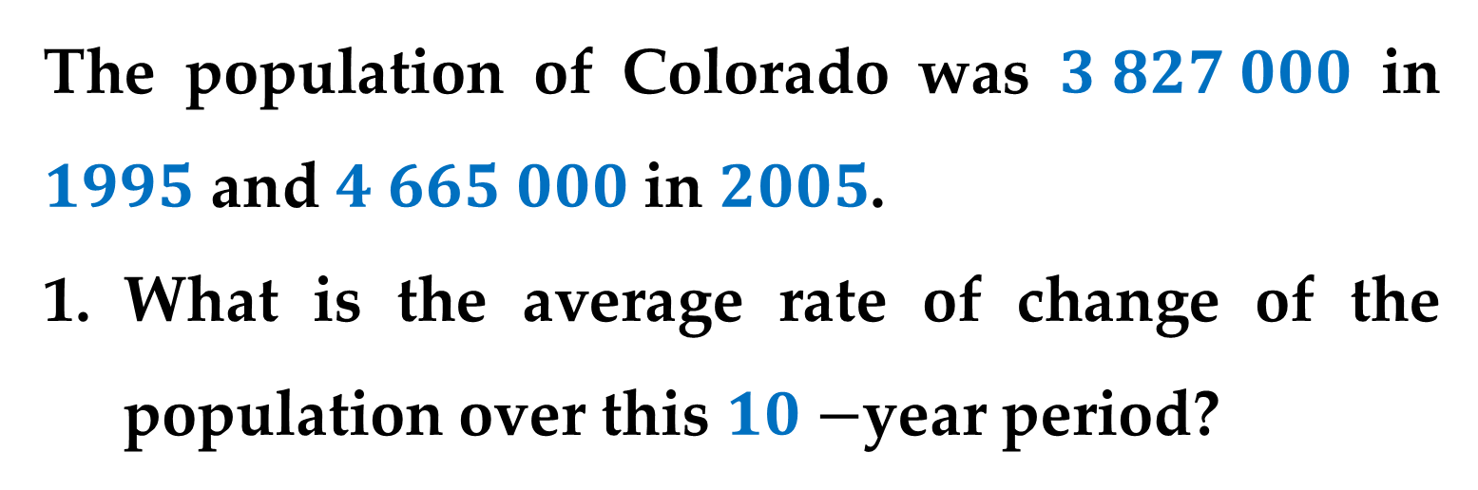
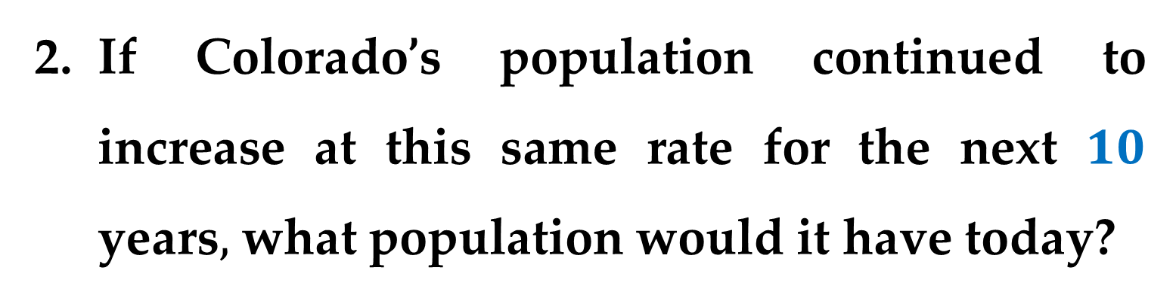
$Example 2$. Population Growth
The population of Colorado was $3 827 000$ in $1995$ and $4 665 000$ in $2005$.
What is the average rate of change of the population over this $10−$year period?
If Colorado’s population continued to increase at this same rate for the next $10$ years$,$ what population would it have today?

Slide 17
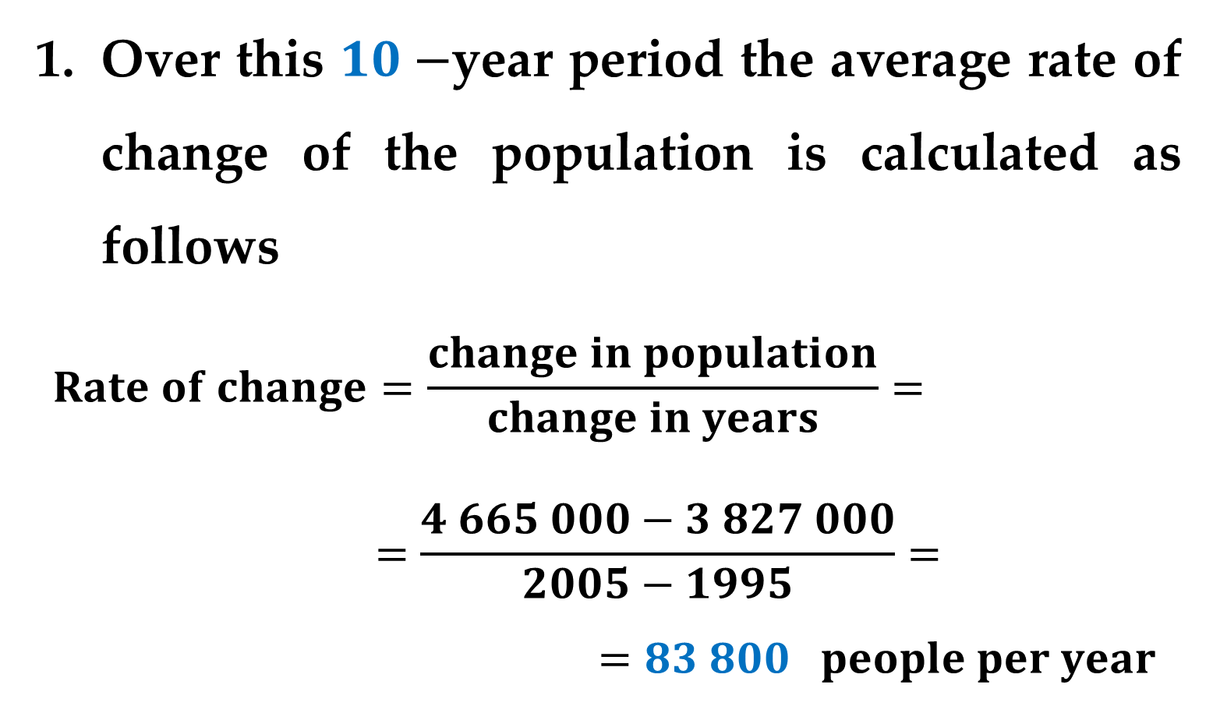
Solution
Over this $10−$year period the average rate of change of the population is calculated as follows
$$Rate of change=\frac{change in population}{change in years}=$$
$$=\frac{4 665 000−3 827 000}{2005−1995}=$$
$$=83 800 people per year$$

Slide 18
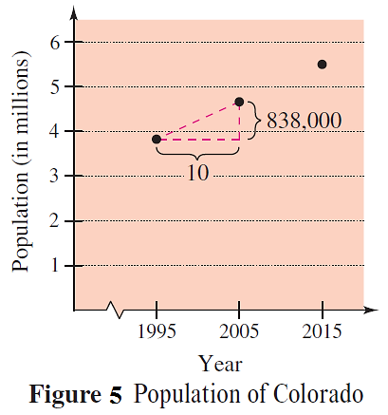
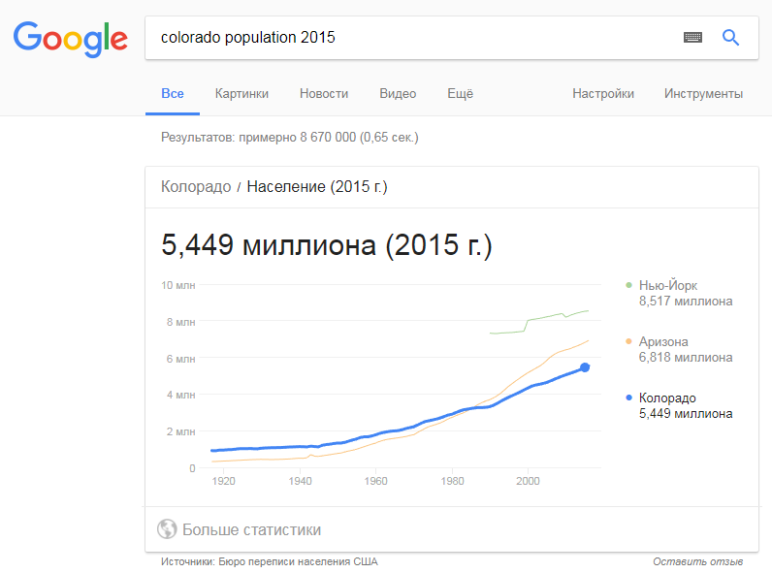
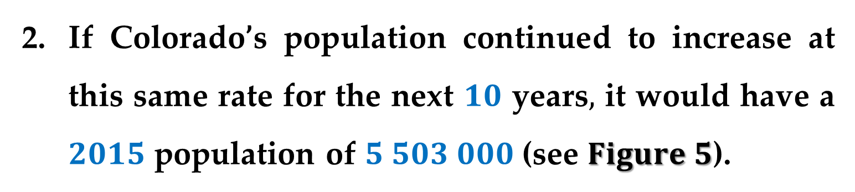
If Colorado’s population continued to increase at this same rate for the next $10$ years$,$ it would have a $2015$ population of $5 503 000$ (see $Figure 5$).

Slide 19
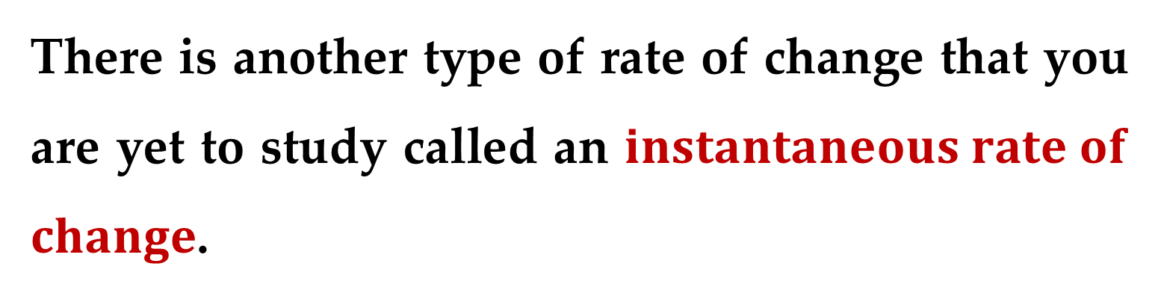
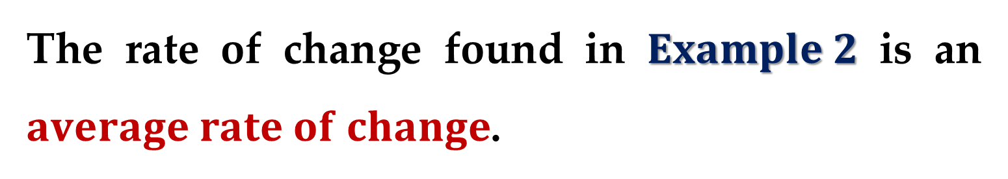
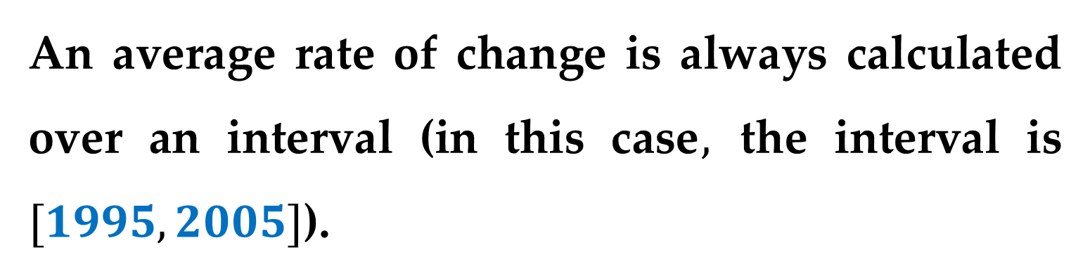
Solution (continued)
The rate of change found in $Example 2$ is an $average rate of change$.
An average rate of change is always calculated over an interval (in this case$,$ the interval is $[1995, 2005]$).
There is another type of rate of change that you are yet to study called an $instantaneous rate of$ $change$.

Slide 20
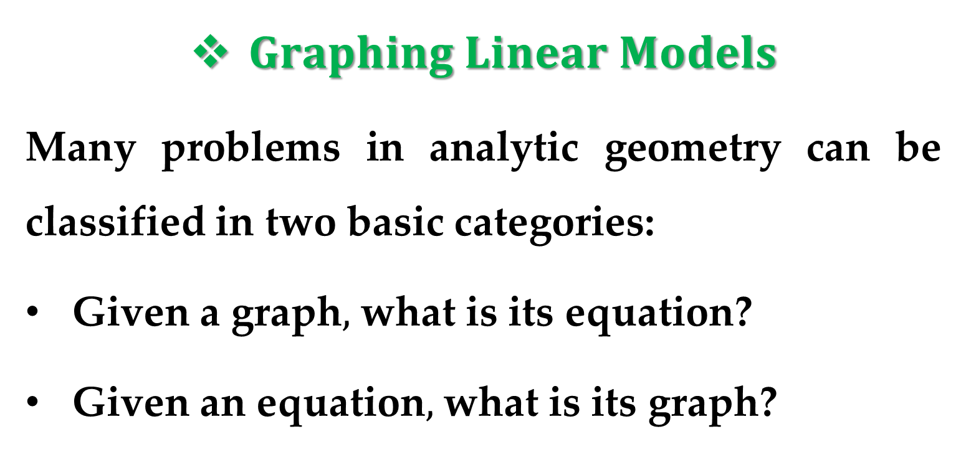
$Graphing Linear Models$
Many problems in analytic geometry can be classified in two basic categories:
Given a graph$,$ what is its equation?
Given an equation$,$ what is its graph?
The point-slope equation of a line can be used to solve problems in the first category.

Slide 21
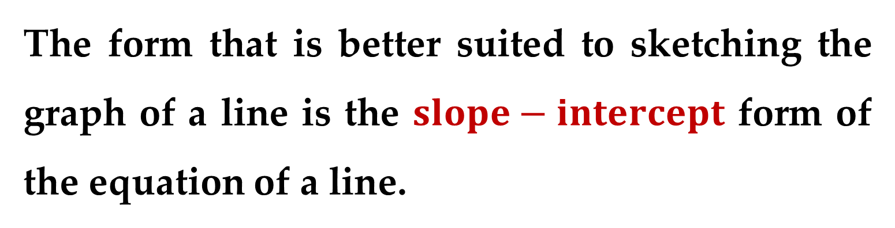
However, this form is not especially useful for solving problems in the second category.
The form that is better suited to sketching the graph of a line is the $slope−intercept$ form of the equation of a line.

Slide 22
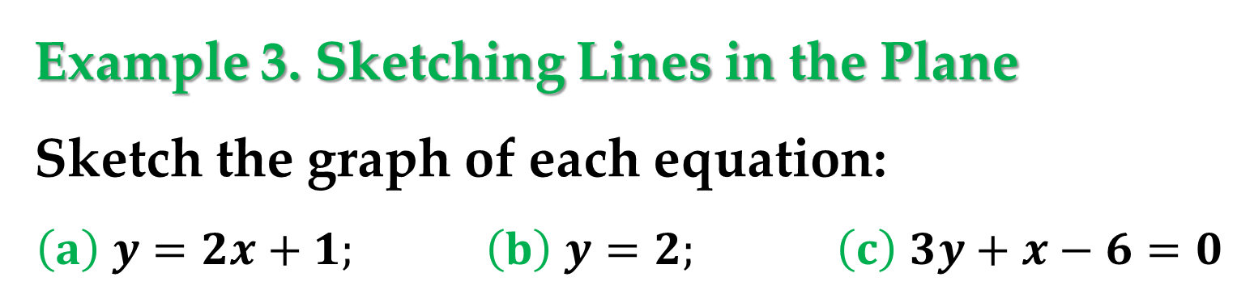
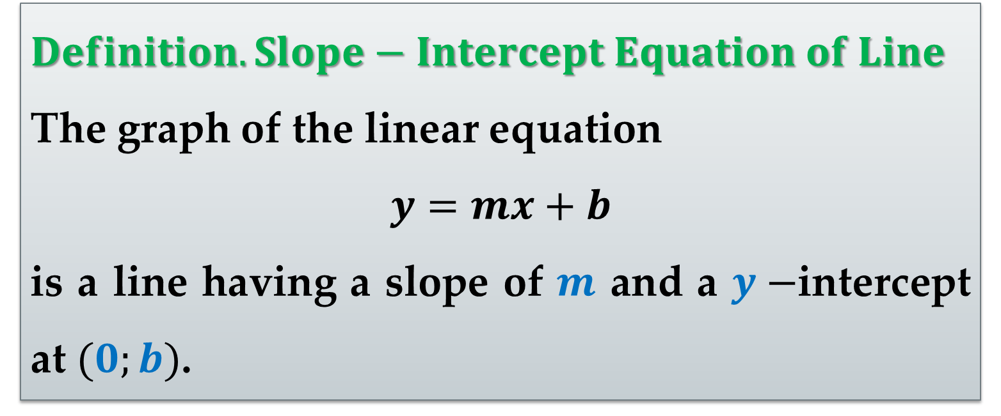
$Definition. Slope−Intercept Equation of Line$
The graph of the linear equation
$$y=mx+b$$
is a line having a slope of $m$ and a $y−$intercept at $(0;b)$.
Example 3. Sketching Lines in the Plane
Sketch the graph of each equation:
$$\left(a\right) y=2x+1; \left(b\right) y=2; \left(c\right) 3y+x−6=0$$

Slide 23
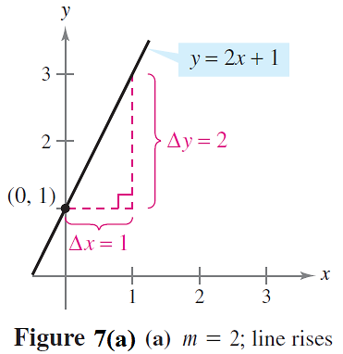

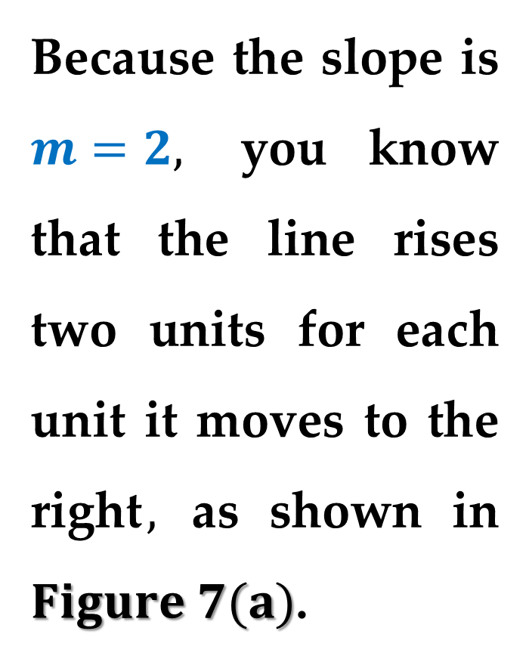
Solution
$\left(a\right)$ Because $b=1,$ the $y−$intercept is $(0;1)$.
Because the slope is $m=2,$ you know that the line rises two units for each unit it moves to the right$,$ as shown in $Figure 7(a)$.

Slide 24
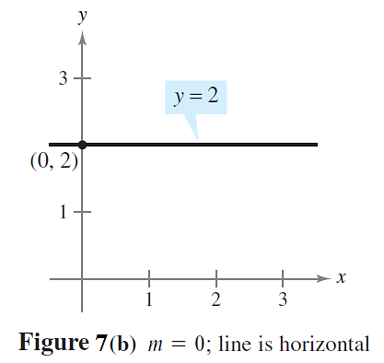
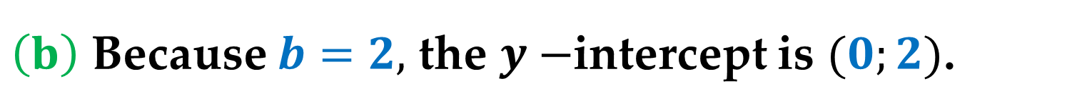
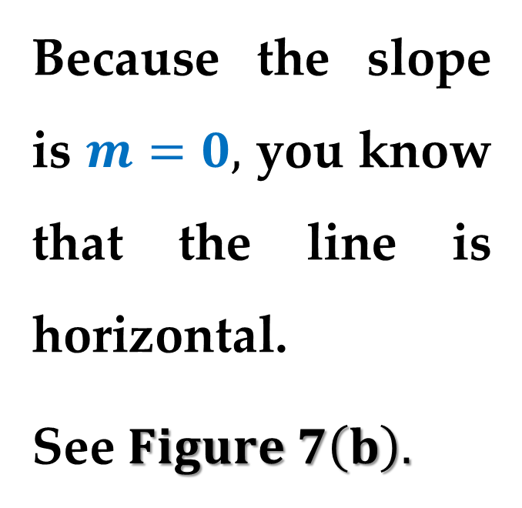
Solution (continued)
$\left(b\right)$ Because $b=2,$ the $y−$intercept is $(0;2)$.
Because the slope is $m=0,$ you know that the line is horizontal.
See $Figure 7\left(b\right).$

Slide 25
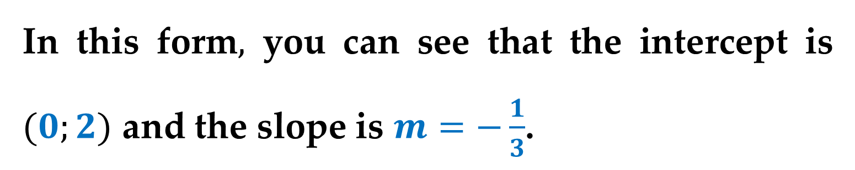
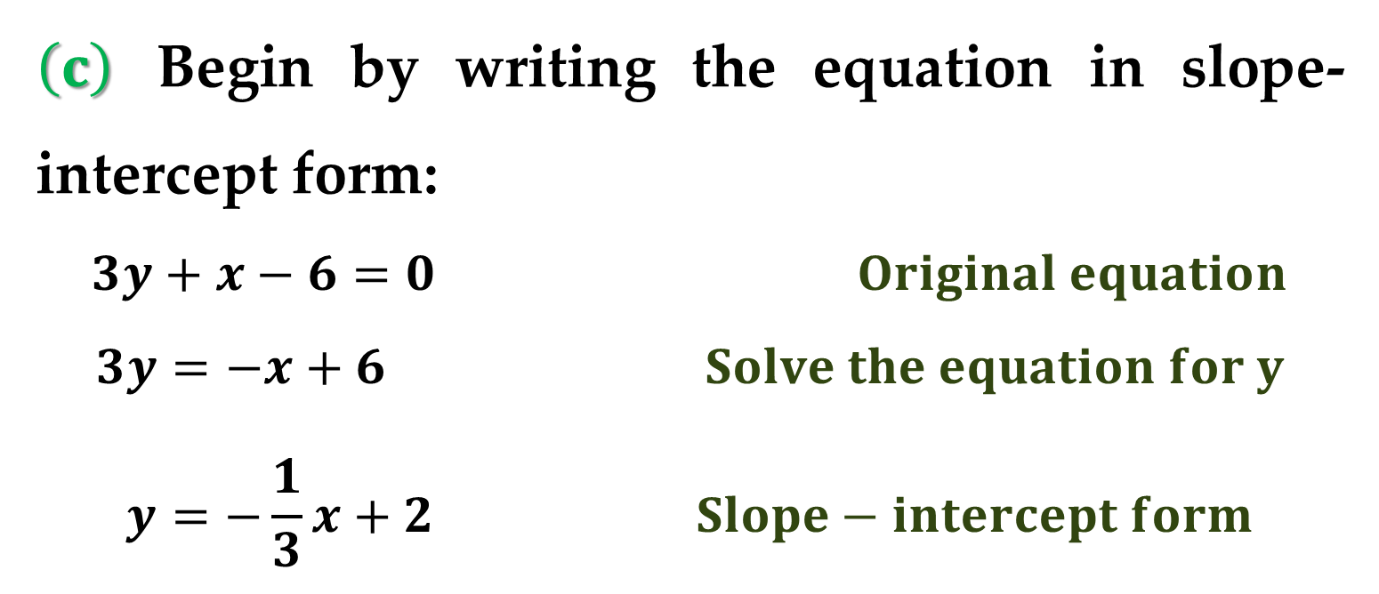
Solution (continued)
$\left(c\right)$ Begin by writing the equation in slope-intercept form:
$$3y+x−6=0 Original equation$$
$$3y=−x+6 Solve the equation for y$$
$$y=−\frac{1}{3}x+2 Slope−intercept form$$
In this form$,$ you can see that the intercept is $(0;2)$ and the slope is $m=−\frac{1}{3}$.

Slide 26
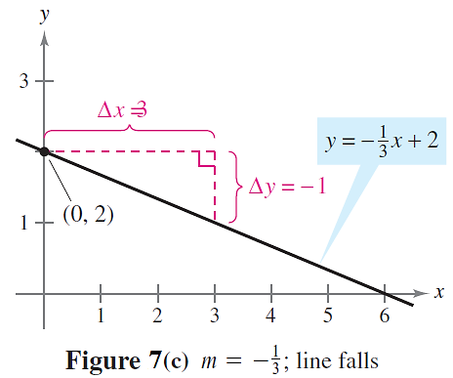
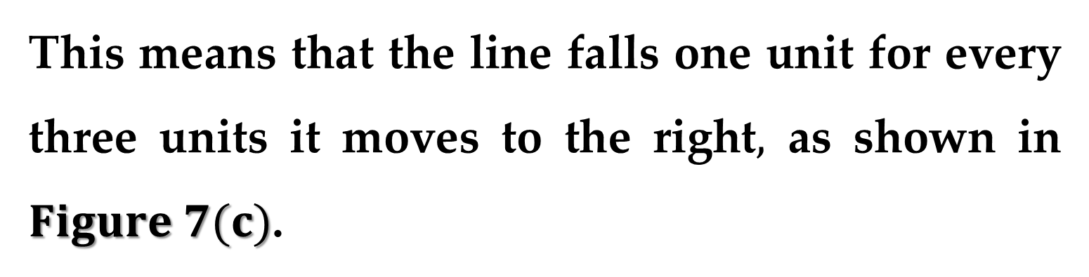
Solution (continued)
This means that the line falls one unit for every three units it moves to the right$,$ as shown in $Figure 7(c)$.

Slide 27
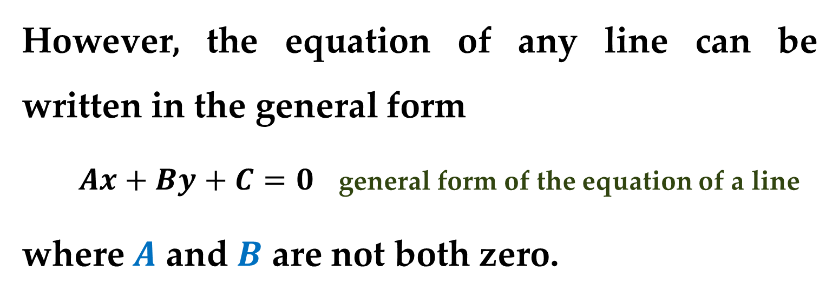
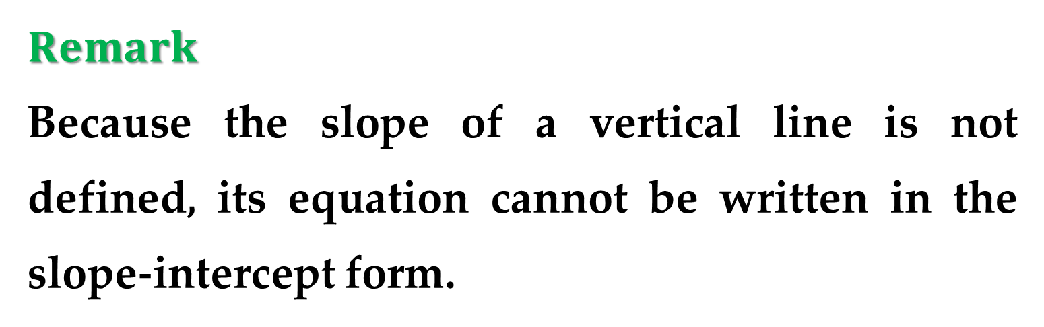
$Remark$
Because the slope of a vertical line is not defined, its equation cannot be written in the slope-intercept form.
However, the equation of any line can be written in the general form
$Ax+By+C=0$ general form of the equation of a line
where $A$ and $B$ are not both zero.

Slide 28
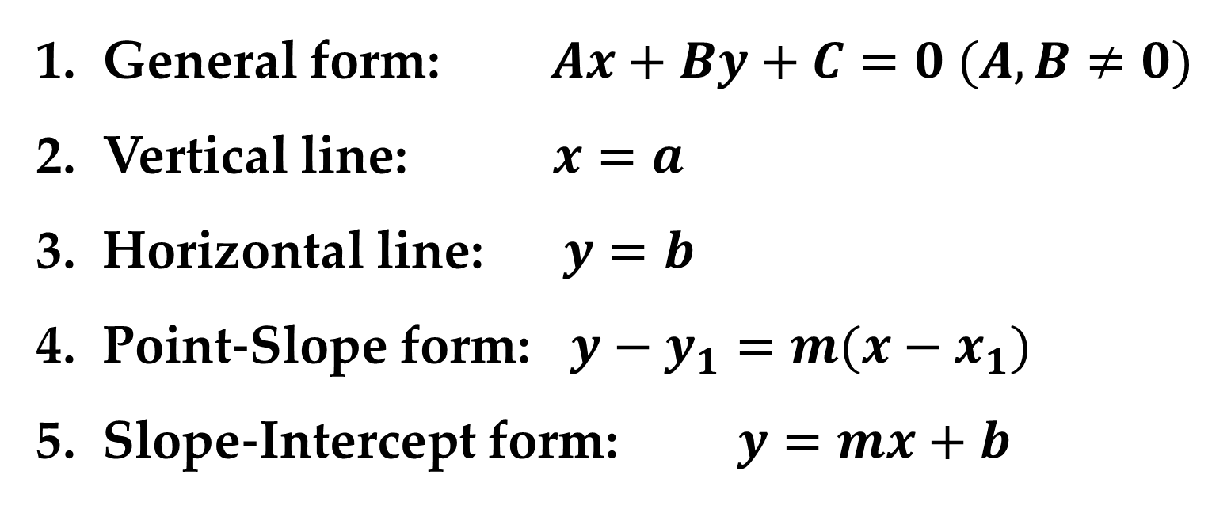

For instance$,$ the vertical line given by $x=a$ can be represented by the general form $x−a=0$.
Summary of Equations of Lines
General form: $Ax+By+C=0 (A,B≠0)$
Vertical line: $x=a$
Horizontal line: $y=b$
Point-Slope form: $y−y_{1}=m(x−x_{1})$
Slope-Intercept form: $y=mx+b$

Slide 29


$Parallel and Perpendicular Lines$
The slope of a line is a convenient tool for determining whether two lines are $parallel$ or $perpendicular$, as shown in $Figure 8$.

Slide 30


$Definition. Parallel Lines$
Two distinct non-vertical lines are $parallel$ if and only if their slopes are equal — i.e. if and only if $m_{1}=m_{2}$.
$Definition. Perpendicular Lines$
Two non-vertical lines are $perpendicular$ if and only if their slopes are negative reciprocals of each other — i.e. if and only if $m_{1}=−1/m_{2}$.

Slide 31


Example 5. Parallel and Perpendicular Lines
Find the general forms of the equations of the lines that pass through the point $(2;−1)$ and are
$\left(a\right)$ parallel to the line $2x−3y=5;$
$\left(b\right)$ perpendicular to the line $2x−3y=5$.
Solution
First write the linear equation $2x−3y=5$ in slope-intercept form: $y=\frac{2}{3}x−\frac{5}{3}$.

Slide 32


Solution (continued)
You can see that the given line has a slope of $m=2/3$.
$\left(a\right)$ The line through $(2;−1)$ that is parallel to the given line also has a slope of $\frac{2}{3}$:
$$y−y_{1}=m(x−x_{1})$$
$$y−\left(−1\right)=\frac{2}{3}(x−2)$$
$$3\left(y+1\right)=2\left(x−2\right) 2x−3y−7=0$$

Slide 33


Solution (continued)
Note the similarity to the original equation.
$\left(b\right)$ Using the negative reciprocal of the slope of the given line$,$ you can determine that the slope of a line perpendicular to the given line is $−\frac{3}{2}$.
So$,$ the line through the point $(2;−1)$ that is perpendicular to the given line can be derived as follows.

Slide 34

Solution (continued)
$$y−y_{1}=m\left(x−x_{1}\right)$$
$$y−\left(−1\right)=−\frac{3}{2}(x−2)$$
$$2\left(y+1\right)=−3(x−2)$$
$$3x+2y−4=0$$

Slide 35
Thank you for attention

